Slide 1
Quantum Computing Shor’s Algorithm (Review)
Dr. William Hutton
Washington State University

Slide 2
But first…
What is Red Teaming?
Notes:
Bonus question: Why do they call it red teaming?

Slide 3

Red Teaming
Notes:
The Prussian army was considered the best fighting force in the world… until a little guy named Napoleon defeated them
Source: The Art of Manliness Podcast (Episode 564 11/27/2019)

Slide 4
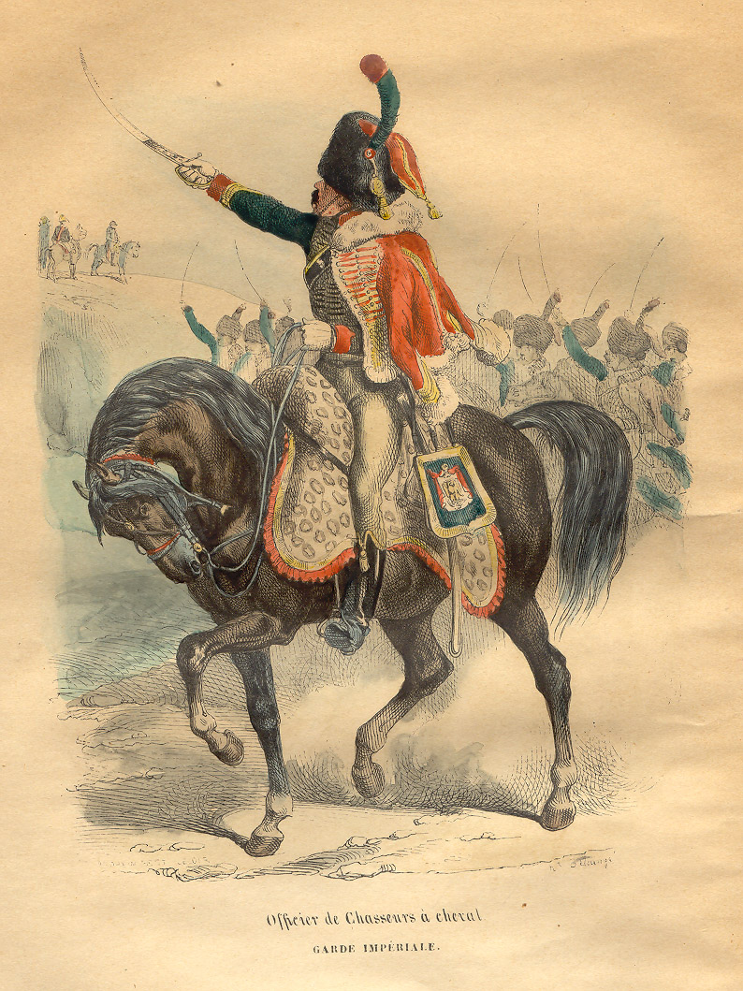
Red Teaming
Notes:
The Prussian army was considered the best fighting force in the world… until a little guy named Napoleon defeated them.
No Prussian general could match Napoleon, but individually there were Prussian generals that were better at one aspect; logistics, strategy, tactics, etc.
The Prussians got together to play “war games” against each other to evaluate the strength of their military plans.
The Prussian uniform was blue.
The French uniform was red.
Source: The Art of Manliness Podcast (Episode 564 11/27/2019)

Slide 5
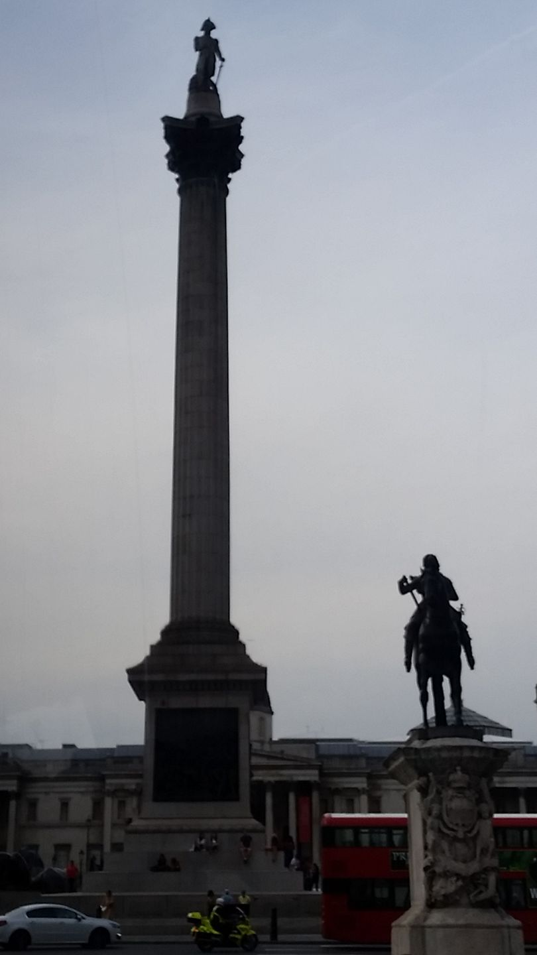
Red Teaming
Notes:
Until Lord Nelson of the British Navy defeated Napoleon.
This is ”Nelson’s Column” in Trafalgar Square in London. (My photo from 2017.)

Slide 6

Red Teaming
Notes:
Four bronze lions guard Nelson’s Column.
The plaques at the base of the column were made from seized French and Spanish cannons.
(My photos from July 2017.)

Slide 7
Review
Encryption is hard, because finding the two prime factors of a very large number is hard for a classical computer.
N = p₁ x p₂
_{15 = 3 x 5}
Notes:
We will be using very small numbers so we can see how the math works.
Q: What is the value of “d” in our example? (2 when N = 15)

Slide 8
Shor’s Algorithm: Step-by-Step (so far…)
Given N, a large number we would like to factor.
What is the first step?
Notes:
A: Just guess ANY number a, such that 2<a<N-1.

Slide 9
Shor’s Algorithm: Step-by-Step (so far…)
Given N, a large number we would like to factor.
Just guess any number, a, s.t. 2<a<N-1.
Notes:
A: Just guess ANY number a, such that 2<a<N-1.

Slide 10
Shor’s Algorithm: Step-by-Step (so far…)
Given N, a large number we would like to factor.
Just guess any number, a, s.t. 2<a<N-1.
Find the period of a^{p} mod N
Notes:
A: Just guess ANY number a, such that 2<a<N-1.

Slide 11
Shor’s Algorithm: Step-by-Step (so far…)
Exponent | Modulus | Answer
7² | 49 % 15 = | 4
7³ | 343 % 15 = | 13
7⁴ | 2,401 % 15 = | 1
7⁵ | 16,807 % 15 = | 7
7⁶ | 117,649 % 15 = | 4
7⁷ | 823,543 % 15 = | 13
Period (r = 4)
Notes:
A: Just guess ANY number a, such that 2<a<N-1.

Slide 12
Shor’s Algorithm: Step-by-Step (so far…)
Given N, a large number we would like to factor.
Just guess any number, a, s.t. 2<a<N-1.
Find the period of a^{p} mod N
Notes:
A: Just guess ANY number a, such that 2<a<N-1.

Slide 13
…
Now jump back to slide X of the “Shor’s Algorithm” lecture.
Check the Speaker Notes for time-synced links to the YouTube video we watched that explains how QFT eliminates wrong answers for p.

